Slide 1

Standards & Regulations
Date: Wednesday, Nov 2 2022

Slide 2

ISO 13482 Robots and robotic devices — Safety requirements for personal care robots

Slide 3
About - ISO 13482
Guidelines for the inherently safe design, protective measures, and information for use of personal care robots
Particularly
Mobile servant robot
Physical assistant robot
Person carrier robot
Notes:
ISO 13482:2014 specifies requirements and guidelines for the inherently safe design, protective measures, and information for use of personal care robots, in particular the following three types of personal care robots:
mobile servant robot;
physical assistant robot;
person carrier robot.
These robots typically perform tasks to improve the quality of life of intended users, irrespective of age or capability. ISO 13482:2014 describes hazards associated with the use of these robots, and provides requirements to eliminate, or reduce, the risks associated with these hazards to an acceptable level. ISO 13482:2014 covers human-robot physical contact applications.

Slide 4
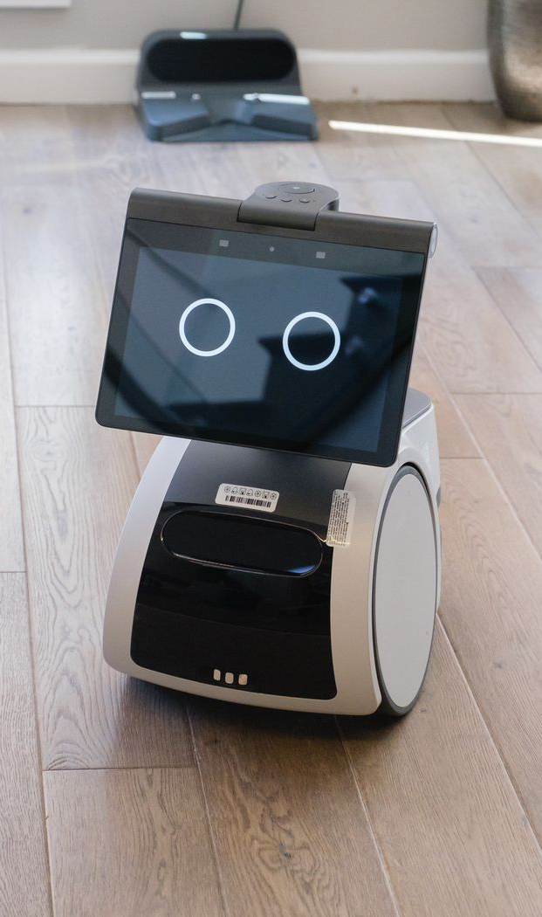
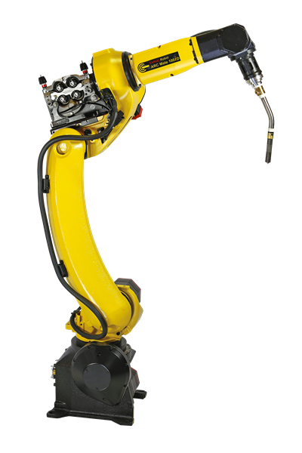

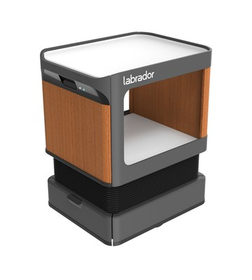

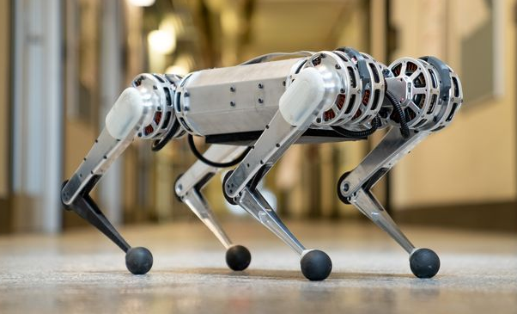
Products - ISO 13482
ISO 13482:2014 presents significant hazards and describes how to deal with them for each personal care robot type.
ISO 13482:2014 covers robotic devices used in personal care applications, which are treated as personal care robots.
ISO 13482:2014 is limited to earthbound robots.
ISO 13482:2014 does not apply to:
robots travelling faster than 20 km/h
robot toys;
water-borne robots and flying robots;
industrial robots, which are covered in ISO 10218;
robots as medical devices;
military or public force application robots.

Slide 5


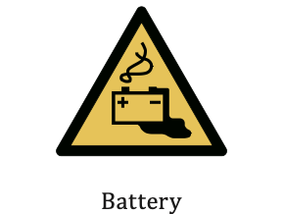
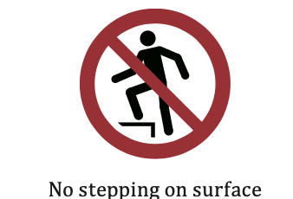
Main prescriptions - ISO 13482
Risk Assessment (Section 4)
A personal care robot shall be designed according to the principles of ISO 12100 (Safety of Machinery) for all hazards identified for its application.
Risk assessment related to robot’s physical parameters, autonomous decision making and foreseeable misuse
Safety requirements and protective measures (Section 5)
General safety, battery hazards, Energy storage and supply, Robot startup and restarts of regular operation, Electrostatic potentials, Robot shape related hazards, Emissions, Vibrations , EM interference
c due to stress, posture and usage, Hazards due to insufficient durability, Hazards due to incorrect autonomous decisions and actions, Hazards due to contact with moving components, Hazards due to lack of awareness of robots by humans, Hazardous environmental conditions, Hazardous environmental conditions
Safety related control systems requirements (Section 6)
Emergency stops, motion/forces related parameters, limited operational spaces, Safety-related environmental sensing, Singularity protection, UI Design, Operation modes, c control devices
Verification and validation (Section 7)
8 pre defined verification methods
Information of use (Section 8)
Development of user/service manual, marking and indications
List of hazards and examples related to personal robots (Annex A-E)
List of potential hazards and use cases to explain standard
Image credits: ISO 13482 - Annex B
Notes:
Jash:

Slide 6
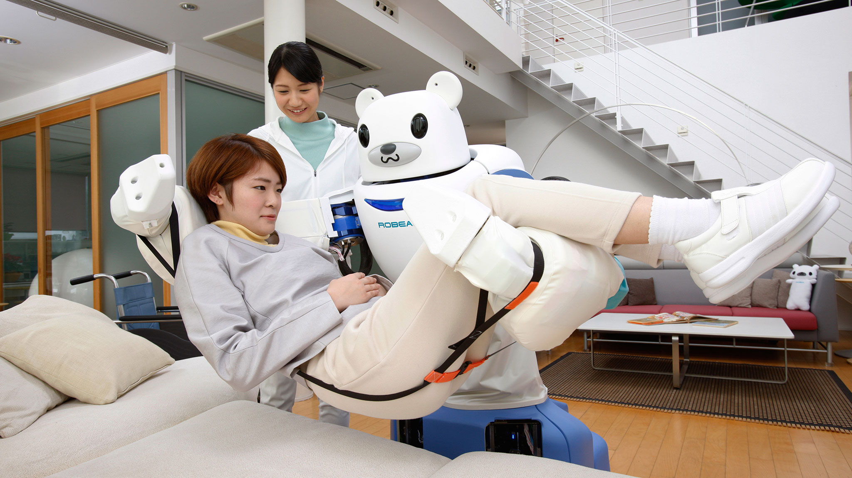
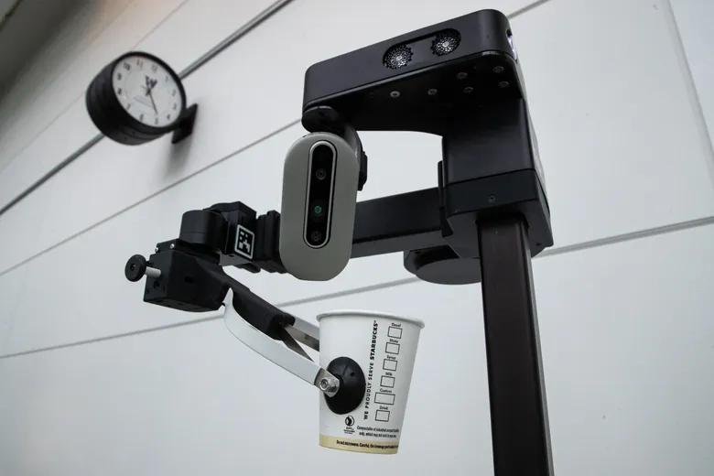
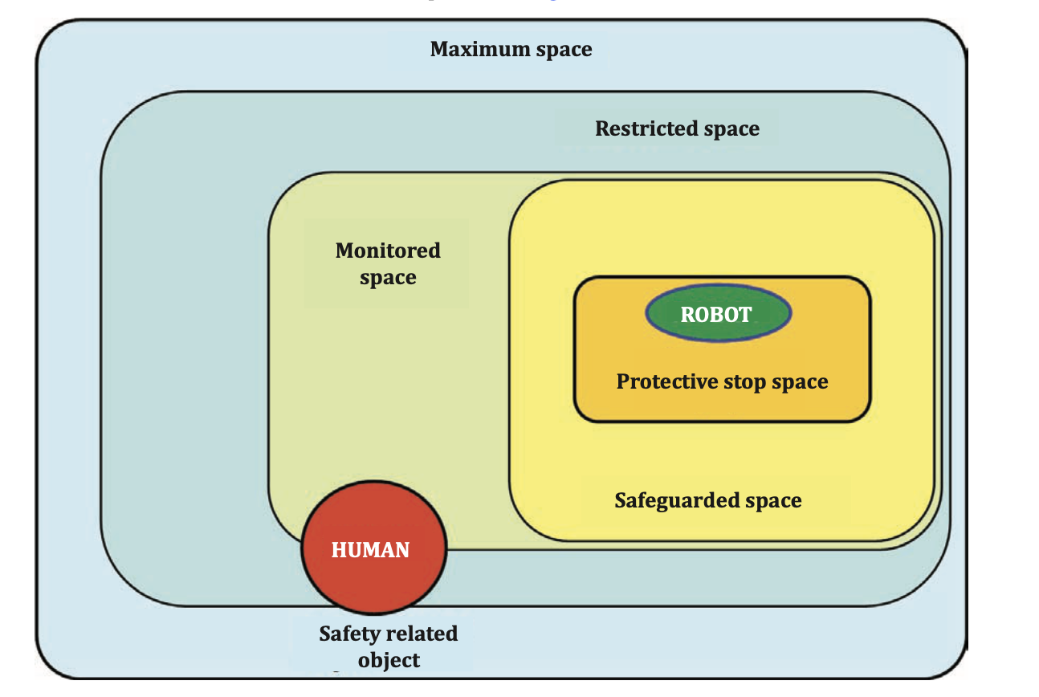
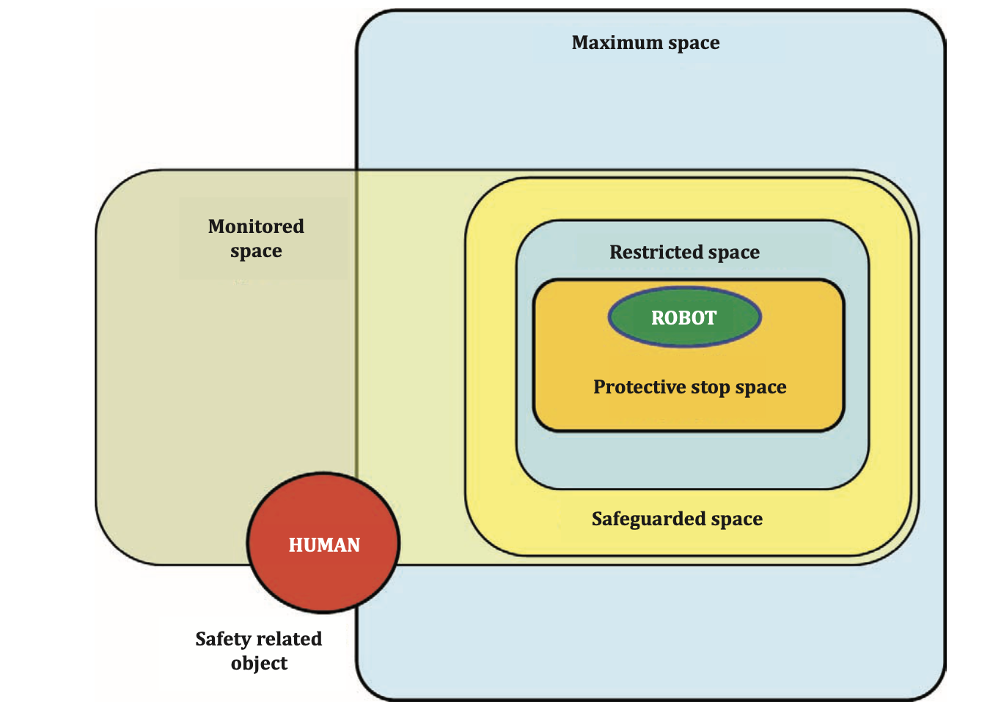
Application in the the Team Project - ISO 13482
Mobile autonomous person carrier (person carrier robot)
A manipulator-type personal care robot (mobile servant robot)
Image credits: ISO 13482 - Annex B, Link1, Link2
Notes:
Jash:

Slide 7
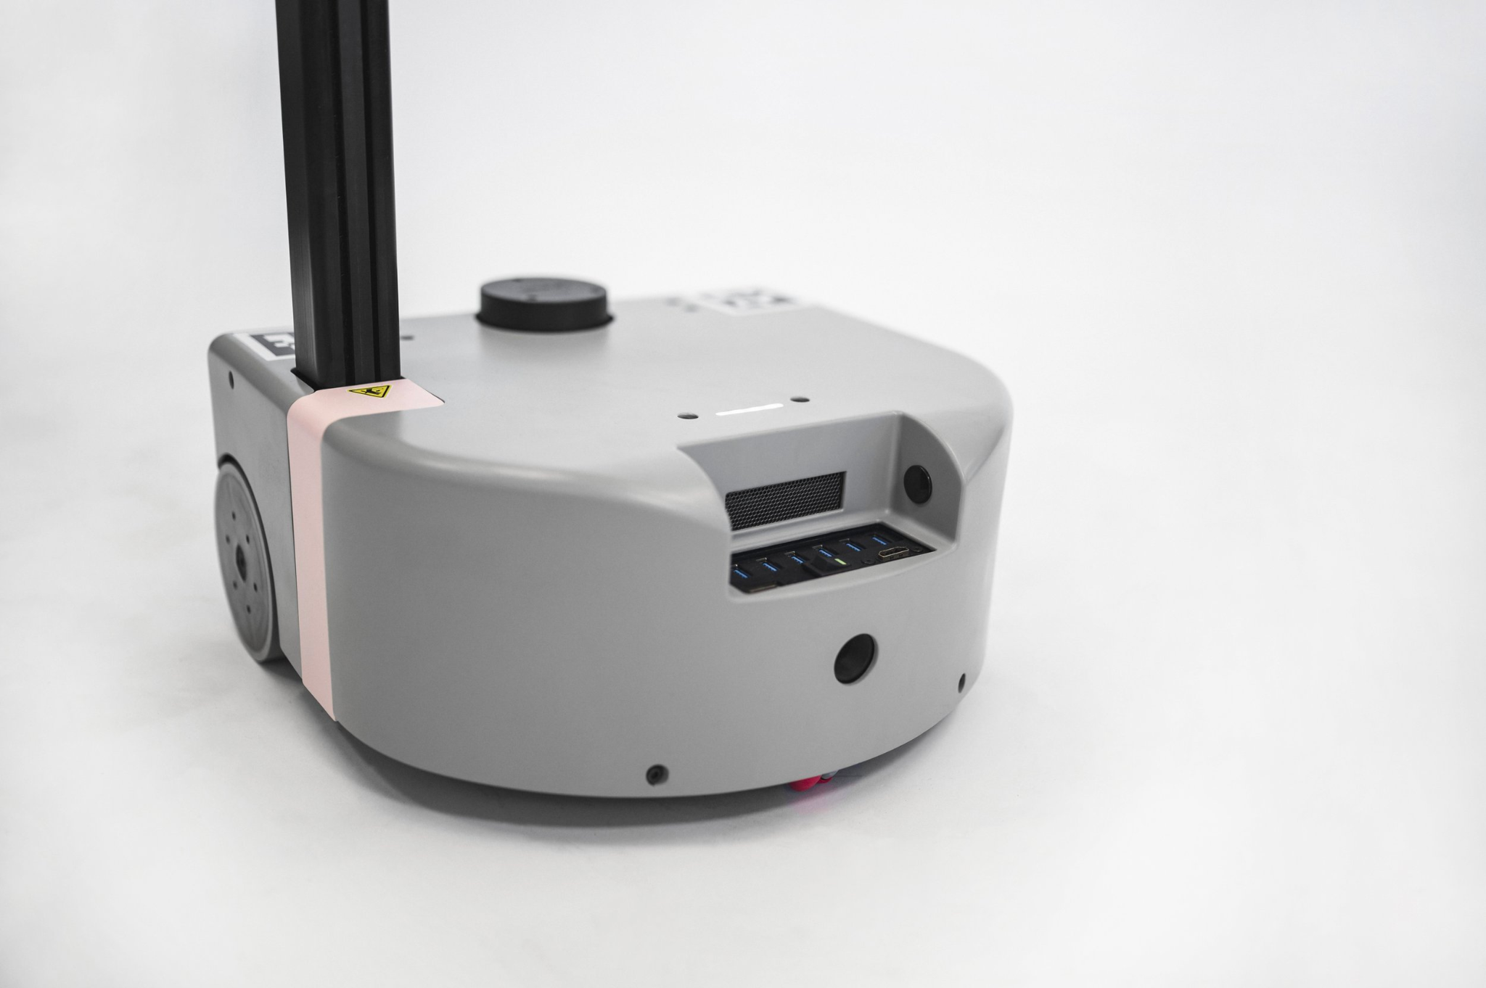
Application in the the Team Project - ISO 13482
Safety related markings

Slide 8
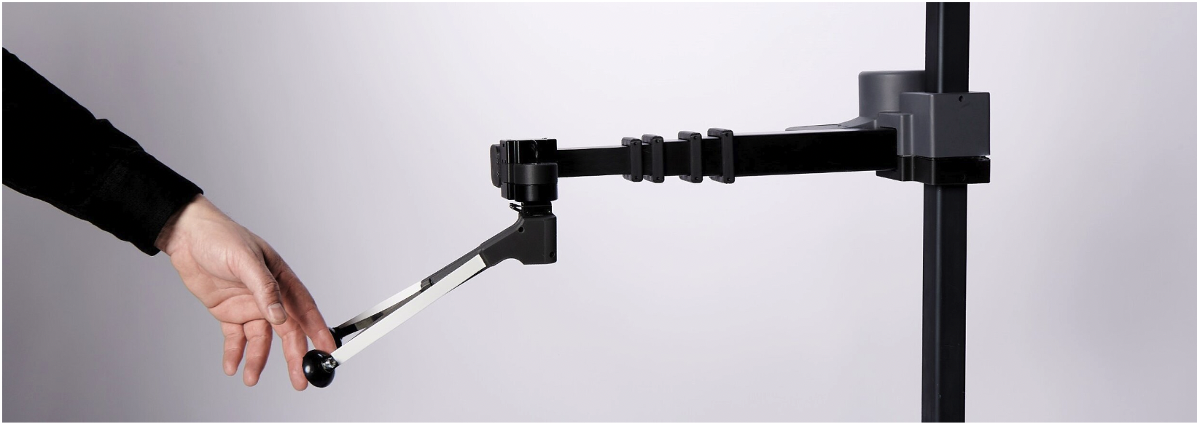
Application in the the Team Project - ISO 13482
According to Hello Robot’s website
Interact with people using a low mass, contact-sensitive body.

Slide 9
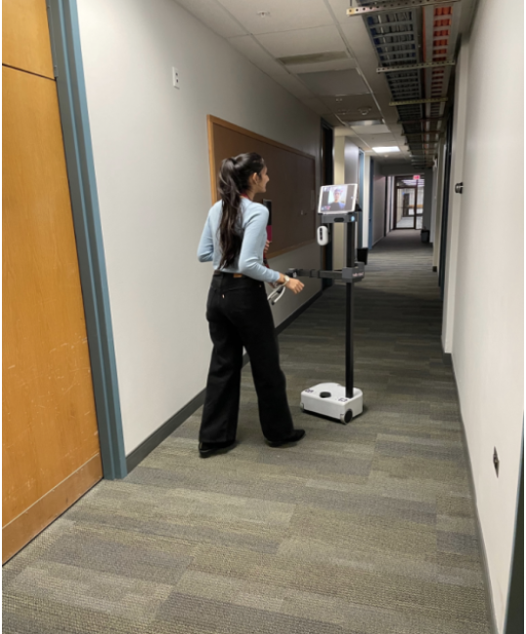
Application in the the Team Project - ISO 13482
TouRI - Mobile servant robot
Autonomous features like navigation and pick and place

Slide 10

Standard - 2
IEEE 1873-2015 Map Data Representation for Navigation

Slide 11
IEEE 1873-2015 - What is the standard about
Map data models and formats for robot navigation tasks.
Common representation of 2D maps - Metric and Topological
XML data format for exchanging maps between robots, computers and other devices
XML format is easy for humans to read and modify
Use the standard to represent metric maps, topological maps and their combination
Notes:
IEEE 1873-2015 Robot Map Data Representation for Navigation, defines a common representation for two-dimensional robot maps and is intended to facilitate interoperability among navigating robots. The standard defines an XML data format for exchanging maps between different systems.

Slide 12
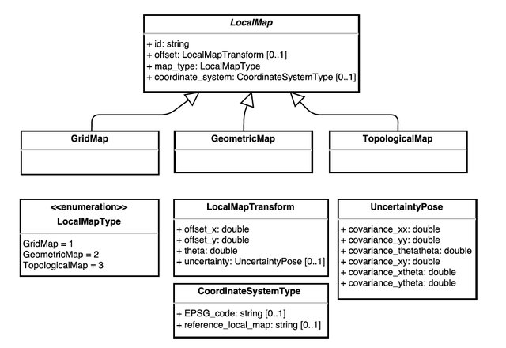
IEEE 1873-2015 - Representations
Build global map of environment by combining maps collected by multiple robots using different modalities
Easily compare and evaluate maps obtained from various robots
3 Types of maps
Grid maps
Geometric maps
Topological maps
Notes:
IEEE 1873-2015 Robot Map Data Representation for Navigation, defines a common representation for two-dimensional robot maps and is intended to facilitate interoperability among navigating robots. The standard defines an XML data format for exchanging maps between different systems. This article illustrates how metric maps, topological maps, and their combinations can be represented according to the standard.

Slide 13
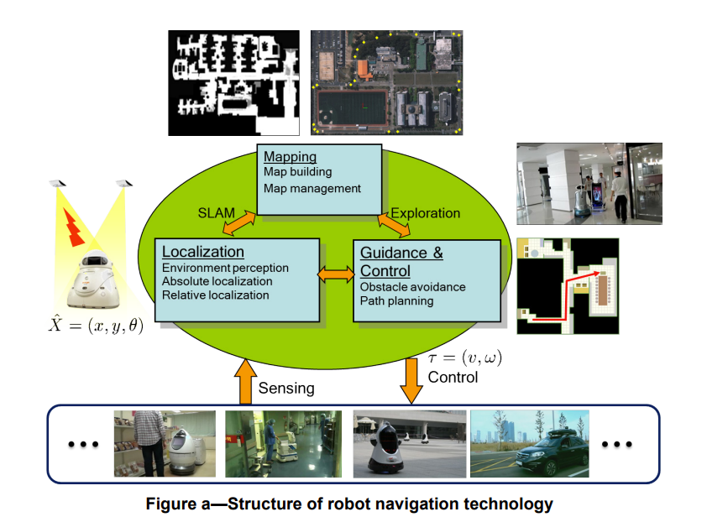
IEEE 1873-2015 - Where can it be used?
Localization
Mapping
Guidance and control
Notes:
IEEE 1873-2015 Robot Map Data Representation for Navigation, defines a common representation for two-dimensional robot maps and is intended to facilitate interoperability among navigating robots. The standard defines an XML data format for exchanging maps between different systems. This article illustrates how metric maps, topological maps, and their combinations can be represented according to the standard.

Slide 14
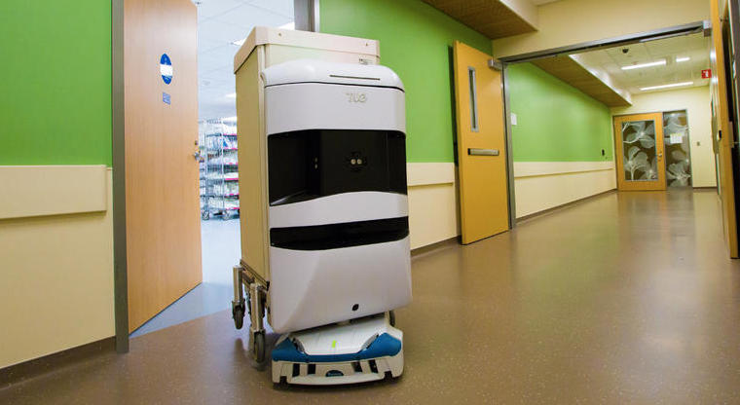
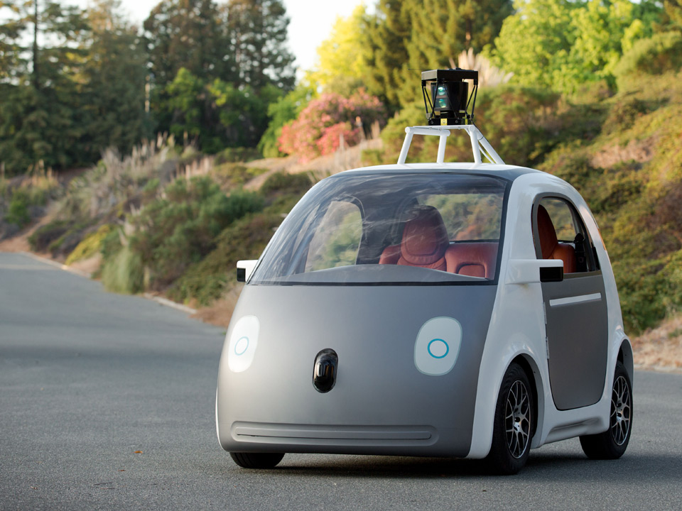
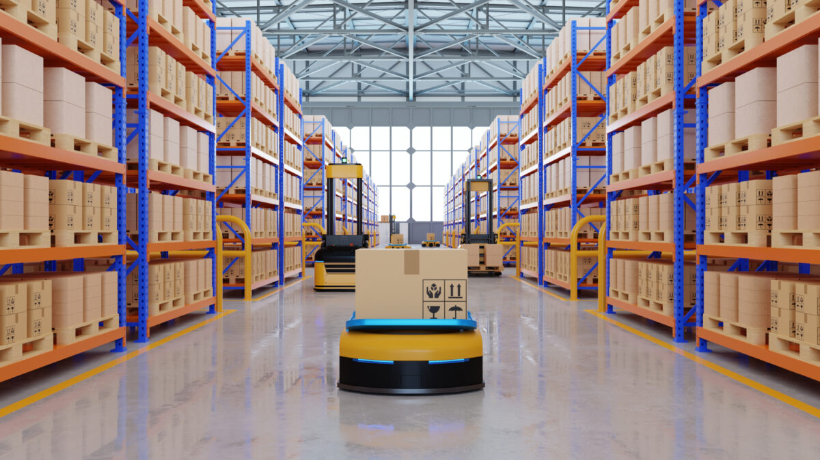
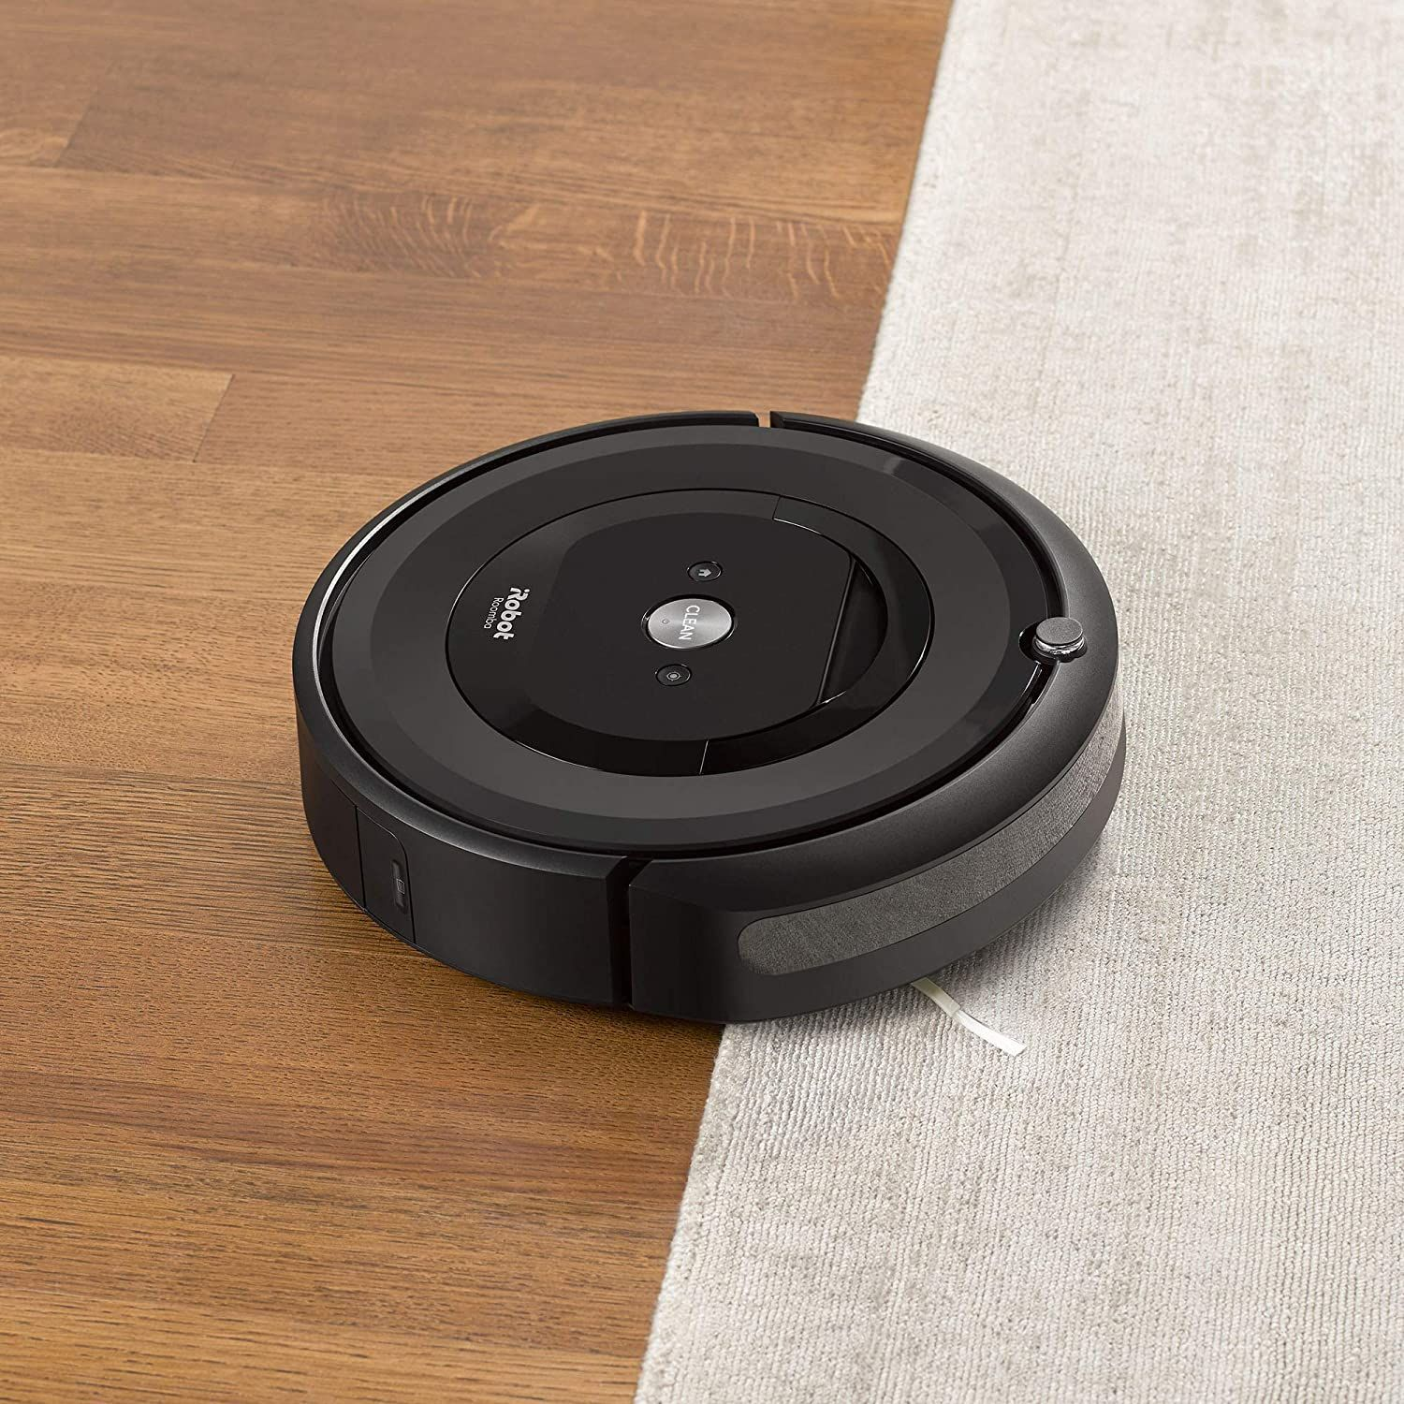
Products- IEEE 1873-2015
ISO 13482:2014 defines a recommended format for exchanging map data among robots, computers, and other devices
ISO 13482:2014 is applicable to all robots that localize using a Map and need interoperable map data.
Surveillance Robots
Hospital Delivery Robots
Home/Social Robots
Warehouse Robots
Self Driving Cars
Notes:
ISO 13482:2014 specifies requirements and guidelines for the inherently safe design, protective measures, and information for use of personal care robots, in particular the following three types of personal care robots:
mobile servant robot;
physical assistant robot;
person carrier robot.
These robots typically perform tasks to improve the quality of life of intended users, irrespective of age or capability. ISO 13482:2014 describes hazards associated with the use of these robots, and provides requirements to eliminate, or reduce, the risks associated with these hazards to an acceptable level. ISO 13482:2014 covers human-robot physical contact applications.

Slide 15
Prescriptions
The MDR standards are applicable to:
Grid Maps
Geometric Maps
Topological Maps
All these maps are inherited from Local Map.

Slide 16
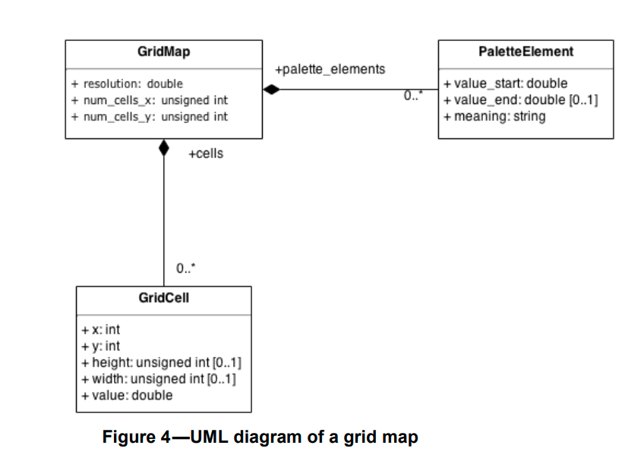
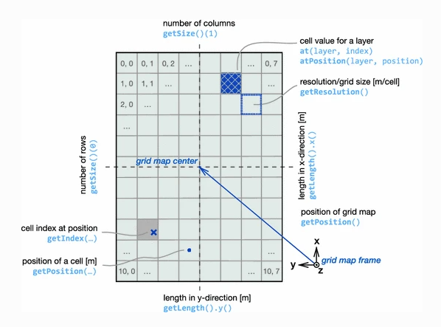
Prescriptions
Grid Maps
The map is represented as square grids with free spaces given value 0 and obstacles given value 255
Typically generated by a scanning laser sensor
Used for self-localization of robot in local area

Slide 17
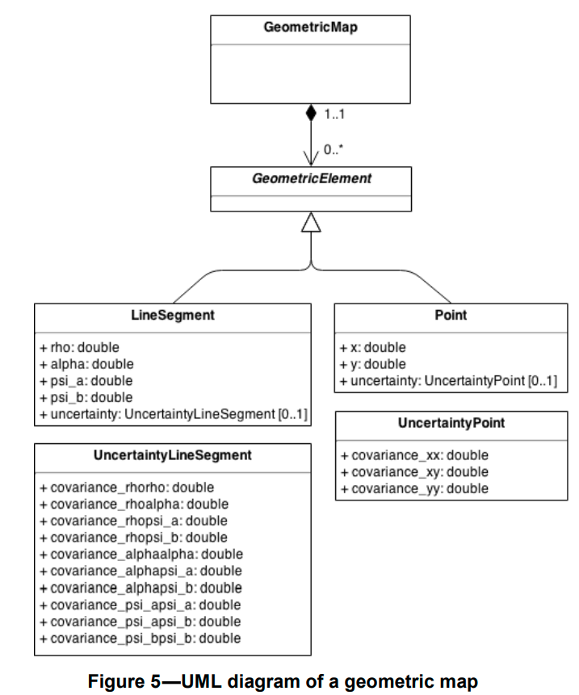
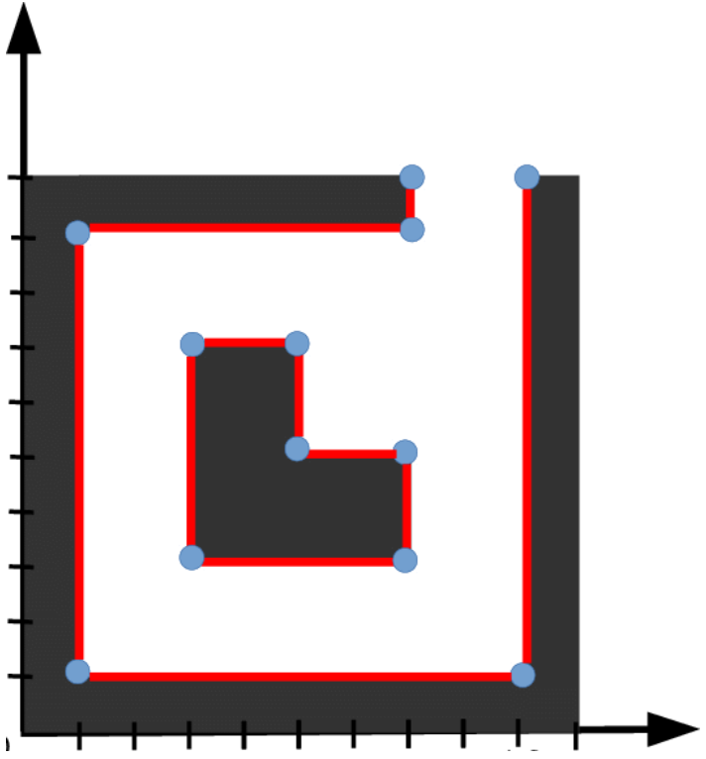
Prescriptions
Geometric Maps
The map is represented as continuous geometric features such as points and line segments
Coordinates are represented as continuous range of values
Used for self-localization of robot in local area

Slide 18
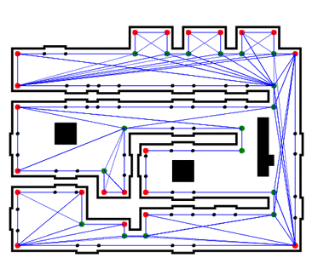
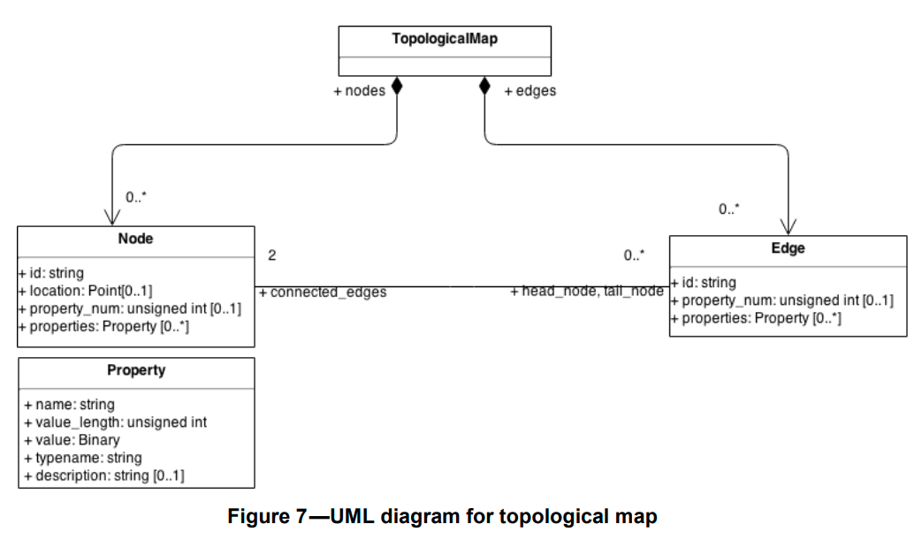
Prescriptions
Topological Maps
The map is represented as a graph consisting of a set of nodes and edges connecting them
Nodes represent poses, sensor readings. Edges connect neighboring nodes
Used for storing visual features, like in a floor plan
Used for global self-localization of robot

Slide 19
Application in TouRI
The map of the environment is represented as an occupancy grid and fed to the robot prior to operation
The map is generated by a LiDAR sensor on the robot
The map is used to provide goal locations to the robot for autonomous traversal and for the self-localization of the robot in local and global areas
Localization is done using the robot localization ROS package that fuses sensor data from wheel encoders, IMU and LiDAR for the same
The progress of the robot on the map is made available to the user through the interface
The map generated is of 8000 * 8000 grids and has a resolution of 0.025 m (metres per occupancy grid block)
The map data conforms to the data format for grid maps (as mentioned above) mentioned by the standard

Slide 20
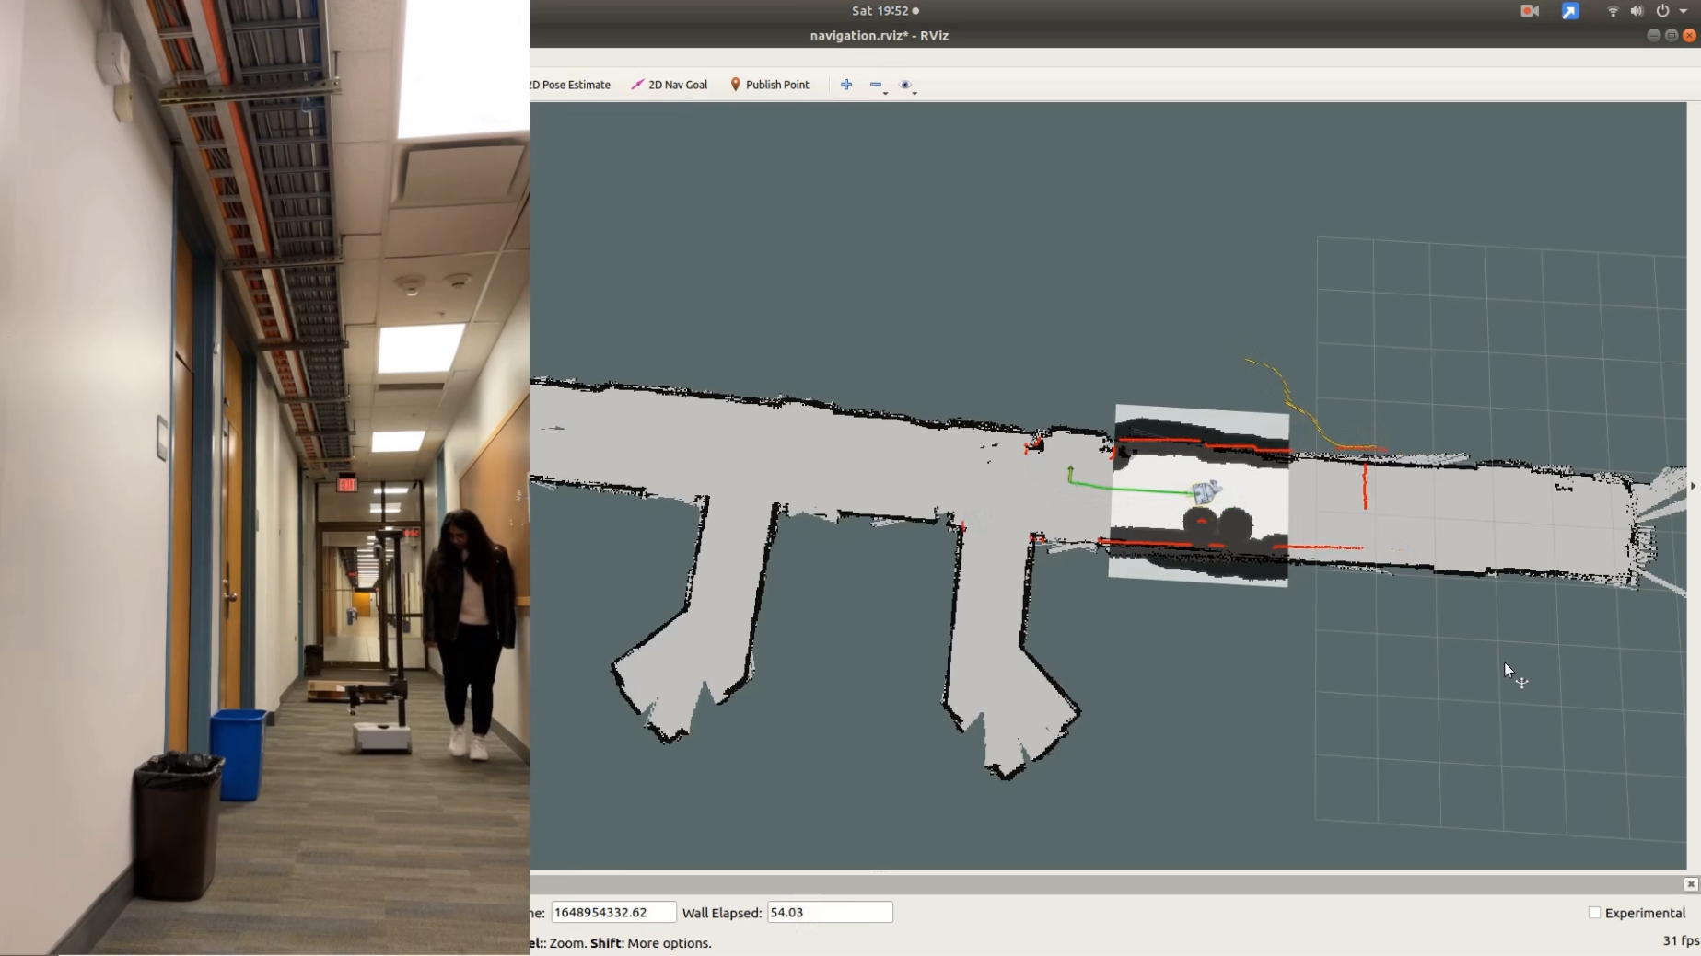
Application in TouRI

Slide 21
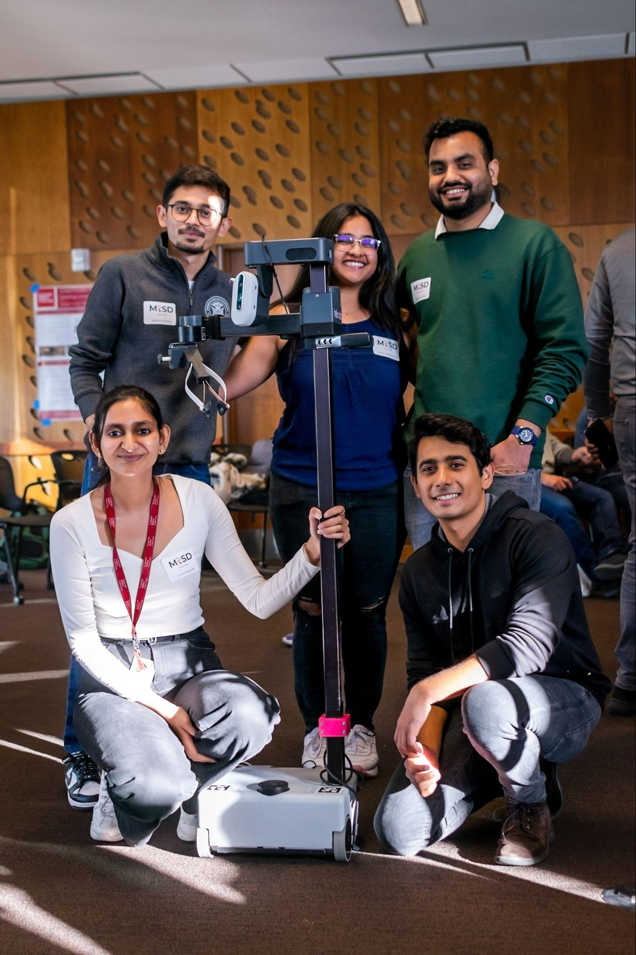
Thank You

Slide 22
Annex A: Safety Validation
A personal care robot shall be designed according to the principles of ISO 12100 for all hazards identified for its application, comprising the following:
inherently safe design
protective measures
information for use
The satisfaction of the safety requirements can be verified by one or more methods, such as:
inspection
practical tests;
measurement
observation during operation
examination of circuit diagrams
examination of software
review of task-based risk assessment
examination of layout drawings and relevant documents

